Slide 1
Source Coding and Kraft Inequality

Slide 2

Source coding (Data Compression)
A source code C for a random variable X is a mapping from X, the range of X, to D∗, the set of finite-length strings of symbols from a D-ary alphabet.
Data compression can be achieved by assigning short descriptions to the most frequent outcomes of the data source, and necessarily longer descriptions to the less frequent outcomes.
Source code C for a random variable X is

Slide 3

Let C(x) denote the codeword corresponding to x and let l(x) denote the length of C(x).
For example, C(red) = 00, C(blue) = 11 is a source code for X = {red, blue} with alphabet D = {0, 1}.
The expected length L(C) of a source code C(x) for a random variable X with probability mass function p(x) is given by

Slide 4
Example
Let X be a random variable with the following distribution and codeword assignment:
Pr(X = 1) = ½ , codeword C(1) = 0
Pr(X = 2) = ¼ , codeword C(2) = 10
Pr(X = 3) = 1/8 , codeword C(3) = 110
Pr(X = 4) = 1/8 , codeword C(4) = 111.
The entropy H(X) of X is 1.75 bits, and the expected length L(C) = El(X) of this code is also 1.75 bits.
Here we have a code that has the same average length as the entropy.
We note that any sequence of bits can be uniquely decoded into a sequence of symbols of X.
For example, the bit string 0110111100110 is decoded as 134213.

Slide 5
Consider another simple example of a code for a random variable:
Pr(X = 1) = 1/3 , codeword C(1) = 0
Pr(X = 2) = 1/3 , codeword C(2) = 10
Pr(X = 3) = 1/3 , codeword C(3) = 11.
The code is uniquely decodable.
However, in this case the entropy is log 3 = 1.58 bits and the average length of the encoding is 1.66 bits.
Here El(X) > H(X).

Slide 6
Morse's code
The Morse code is a reasonably efficient code for the English alphabet using an alphabet of four symbols: a dot, a dash, a letter space, and a word space.
Developed for electric telegraph system
D = (dot, dash, letter space, word space)
Short sequences represent frequent letters
Long sequences represent infrequent letter

Slide 7
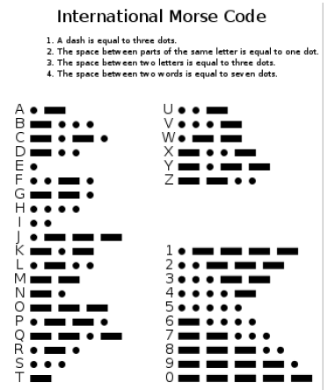

Slide 8
Source coding applications
Magnetic recording: cassette, hardrive, USB...
Speech compression
Compact disk (CD)
Image compression: JPEG
Still an active area of research:
Solid state hard drive
Sensor network: distributed source coding

Slide 9
Classes of Codes
Non – Singular
Extension
Uniquely decodable
Prefix codes

Slide 10

Non singular
A code is said to be non singular if every element of the range of X maps into a different string in D∗; that is,
No two elements of X can have the same codeword
Non singularity suffices for an unambiguous description of a single value of X.
But we usually wish to send a sequence of values of X.
In such cases we can ensure decodability by adding a special symbol (a “comma”) between any two codewords.
But this is an inefficient use of the special symbol; we can do better by developing the idea of self punctuating or instantaneous codes

Slide 11

Extension
The extension C∗ of a code C is the mapping from finite length strings of X to finite-length strings of D, defined by
where C(x1)C(x2) · · · C(xn) indicates concatenation of the corresponding codewords.
If C(x1) = 00 and C(x2) = 11, then C(x1x2) = 0011.

Slide 12
Uniquely Decodable
A code is called uniquely decodable if its extension is nonsingular.
Concatenation of two codewords should not results into another codeword
In other words, any encoded string in a uniquely decodable code has only one possible source string producing it.
However, one may have to look at the entire string to determine even the first symbol in the corresponding source string.

Slide 13
Prefix code
A code is called a prefix code or an instantaneous code if no codeword is a prefix of any other codeword.
An instantaneous code can be decoded without reference to future codewords since the end of a codeword is immediately recognizable.
Hence, for an instantaneous code, the symbol xi can be decoded as soon as we come to the end of the codeword corresponding to it.
We need not wait to see the codewords that come later.
An instantaneous code is a selfpunctuating code; we can look down the sequence of code symbols and add the commas to separate the codewords without looking at later symbols.

Slide 14
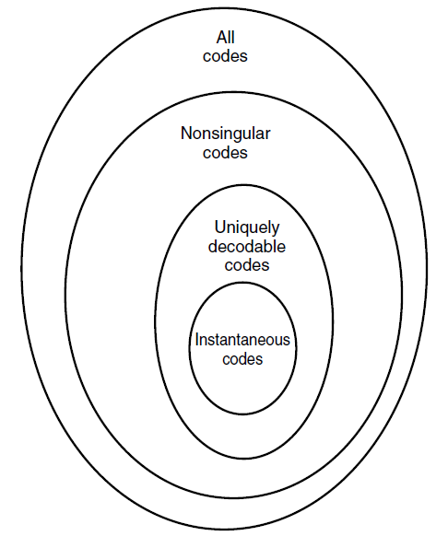
The nesting of these definitions is shown

Slide 15
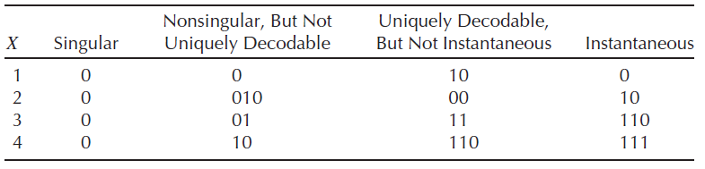

Slide 16
KRAFT INEQUALITY
We wish to construct instantaneous codes of minimum expected length to describe a given source.
It is clear that we cannot assign short codewords to all source symbols and still be prefix-free.
The set of codeword lengths possible for instantaneous codes is limited by the following inequality.

Slide 17

(Kraft inequality) For any instantaneous code (prefix code) over an alphabet of size D, the codeword lengths L1, L2, . . . , Lm must satisfy the inequality
Conversely, given a set of codeword lengths that satisfy this inequality, there exists an instantaneous code with these word lengths.

Slide 18
Assignment
Group 1: Identify the total number of word that can be constructed in Swahili language (e.g Hello, Mambo, poa, ni, na, etc). Then Develop codewords for Kiswahili words as source Elements
Group 2: Identify the total number of word that can be constructed in English language (e.g how, and, a, the, one, for etc). Then Develop codewords for English words as source Elements

Slide 19
END

